Slide 1
JCR for Developers
Notes:
1

Slide 2
Table of Content
JCR Concept
JCR Specification
JCR Key Features (Namespaces, Node Types, Inheritance, Properties, Mixins)
JCR Export & Import
JCR Queries
JCR Configuration
Code Examples
Exercises
Notes:
2

Slide 3
JCR Concept
Notes:
3

Slide 4
Introduction
Java Content Repository (Specification JSR 170)
http://jcp.org/aboutJava/communityprocess/final/jsr170/index.html‏
Content repository
Hierarchical structure
Used like a file system in eXo
Advances services (queries, locks, versioning,...)‏
Notes:
4

Slide 5
Introduction
Notes:
5

Slide 6
Introduction
One or several repositories
One eXo instance only configures one repository
Multiple repositories are only used for multi-tenants (eXo Cloud)
Each repository has several workspace
There are about 10 workspace in eXo Platform 3.5
One workspace for a set of features (example Knowledge features)
Each workspace has one root node
Each node can have child nodes
Each nodes can have properties
Properties can be of different types (text, binary, number, …)
Notes:
6

Slide 7
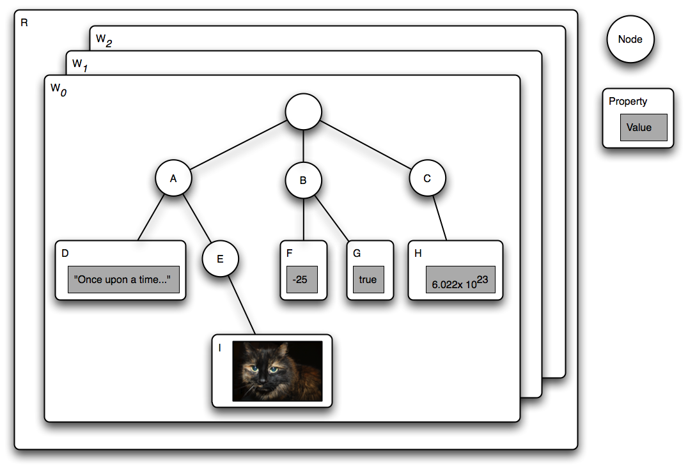
Introduction
Notes:
7

Slide 8
Introduction
eXo uses JCR to manage all persistent data storage :
Portal Configuration (pages, navigations, preferences...)‏
DMS and WCM (eXo ECM)‏
Knowledge, Collaboration, Social
Available for your application development, but you are not forced to use it.
Notes:
8

Slide 9
Introduction
Common java API for all content workspaces
Agnostic to datasource, protocol and architecture
Standardize complex features
Useful for content oriented applications
Notes:
9

Slide 10
JCR Specification
Notes:
10

Slide 11

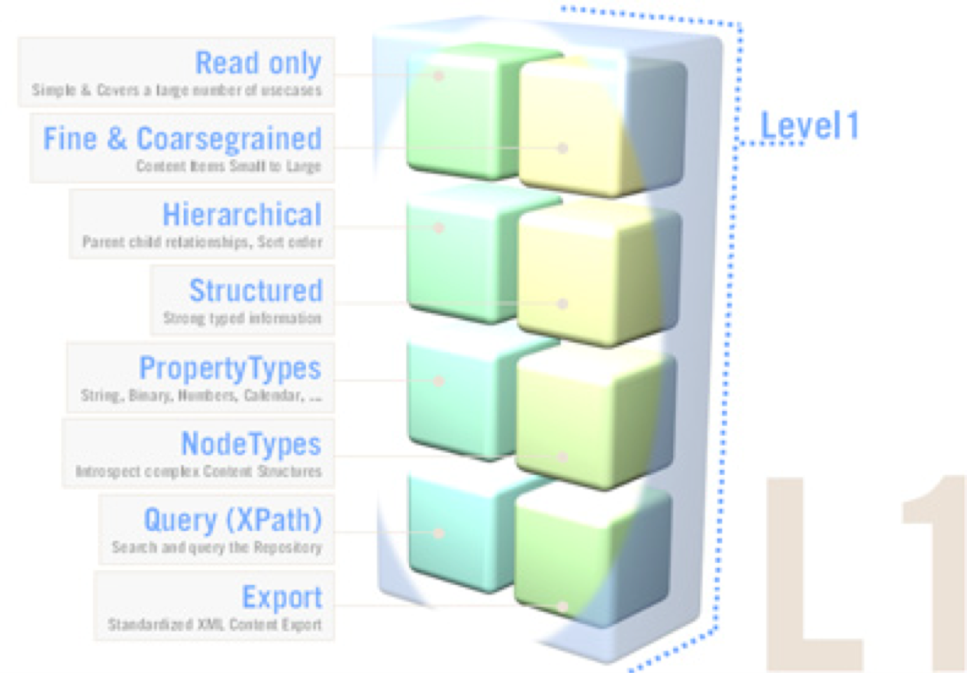
JCR Spec Level 1
Level 1 includes :
access methods to the current repository
read method to access items
XML export
XPath query possibility
nodeType management
Namespace management
Notes:
11

Slide 12

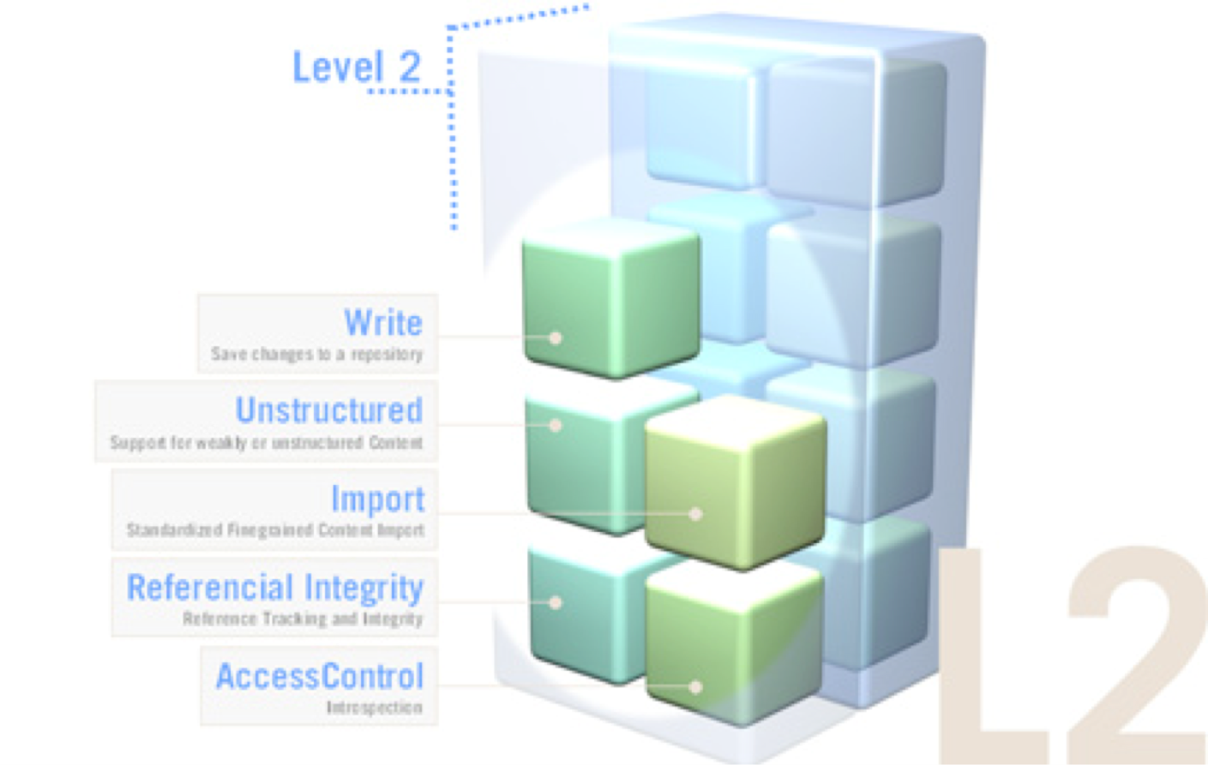
JCR Spec Level 2
Level 2 includes :
write methods to repository
XML import format
Possibility to modify a node path (copy, move, clone, update)
Referential integrity
Notes:
12

Slide 13

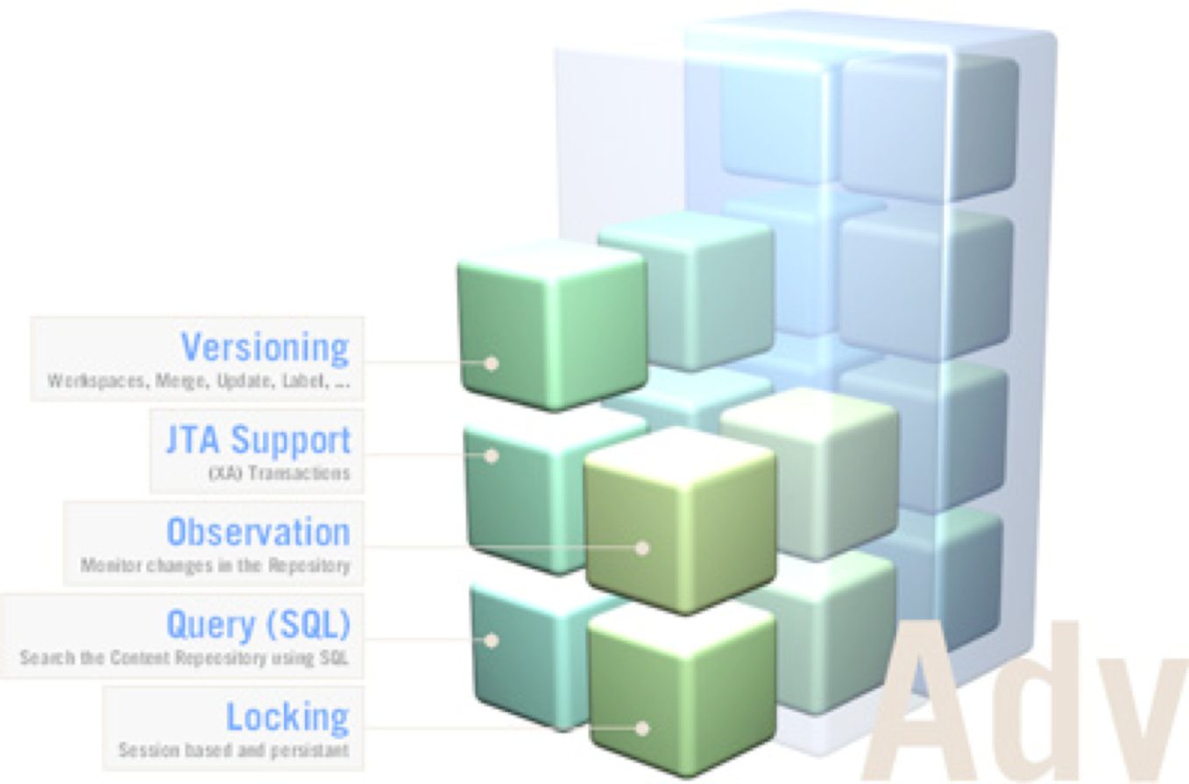
JCR Spec Level 2
Optional features include :
versioning
locking
observation
possibility to make JCR-SQL queries
transactions
Notes:
13

Slide 14
JCR eXo Features
Proprietary eXo extensions are :
Possibility to configure the JCR from XML configuration
NodeType Storing extension
Security management thru JAAS
Advanced access management
Notes:
14

Slide 15
JCR eXo Features
Security is natively linked to the organizational service: each node can be associated to a membership or a group, or a full set of permissions
Read, Write, Modify, Delete
Different ways to access the API
WebDAV, JCR RMI, REST API, CMIS
XML Configuration XML for JCR by plugins
Repository
Workspace
NameSpace
NodeType
Notes:
15

Slide 16
JCR Key Features
Notes:
16

Slide 17


Features Introduction
Example exo:article
3 properties
title
summary
content
many sub-nodes files
Notes:
17

Slide 18
JCR Namespaces – like XML Namespaces
Prefix is a NameSpace shortcut, which is a URI. URIs are used to avoid collisions risks.
Each repository has a single, persistent namespace registry.
A prefix, delimited by a single ':' (colon) character that indicates the namespace of the item.
NameSpace referential contains the following reserved names :
jcr: Used for JCR internal types. Do not use it.
nt: Used by primary types. Do not use it.
mix: Used for the names of built-in mixin node types. Do not use it.
xml: Used for XML compliance. Do not use it.
“”: Indicates the default namespace
Notes:
18

Slide 19
JCR Primary Node Type
Every node must have one and only one «primary node type»
The primary node defines names, types and others accepted properties for this node.
Each node contains a specific property called jcr:primaryType which contains the name of the primary type of the node.
A primary node always inherits from a supertype. The root node type is nt:base. “nt:base” is the base type for all other types.
A primary node type inherits also the mixin types that are assigned to the supertype.
Notes:
19

Slide 20
JCR Mixin Node Type
A node can possess one or many mixin types.
A mixin type just adds properties and child node requirements to a node that already has a primary node type. It cannot serve, by itself, to define the structure of a node.
There is no required supertype for mixin types
A particular supported node type is either a primary type or a mixin type; it cannot be both.
When you add a mixin nodetype to a node, the node acquires a new property called jcr:mixinTypes. This multi-value property contains the mixin types.
Notes:
20

Slide 21
Predefined Mixin Node Types
mix:referenceable: - This node type specifies an auto-created, mandatory, STRING property called jcr:uuid. This property is set automatically by the implementation when the mix:referenceable node is created or when this mixin type is added to an existing node. - A node must be mix:referenceable in order to be the target of a REFERENCE property.
mix:versionable: This mixin node type supports the versioning system. For a node to be versionable, it must be of this mixin node type.
mix:lockable: Only nodes with mixin node type mix:lockable may hold locks.
Notes:
21

Slide 22
JCR Locking
This feature allows a user to temporarily lock nodes in order to prevent other users from changing them.
Only nodes with mixin node type mix:lockable (inherited as part of their primary node type or explicitly assigned) may hold locks.
A lock can be specified as either shallow or deep. A shallow lock applies only to its holding node. A deep lock applies to its holding node and all its descendants.
The user who places a lock on a node is called the lock owner.
Notes:
22

Slide 23
Same Name Siblings
Support for same name siblings is optional in JCR specification.
A particular node within a same-name sibling group can be addressed by embedding an array-like notation within the path.
For example the path /a/b[2]/c[3] specifies the third child node called c of the second child node called b of the node a below the root.
/a/b/c is equivalent to /a[1]/b[1]/c[1].
Always have in mind that they might be same name siblings in your system, created by end-user manipulation.
Properties cannot have sibling properties of the same name.
Notes:
23

Slide 24
JCR Property Types 1/2
PropertyType.STRING
PropertyType.BINARY
PropertyType.LONG
PropertyType.DOUBLE
PropertyType.BOOLEAN
PropertyType.DATE
PropertyType.NAME
PropertyType.PATH
PropertyType.REFERENCE
Notes:
24

Slide 25
JCR Property Types 2/2
PropertyType.DATE ISO 8601:2000-compliant format: sYYYY-MM-DDThh:mm:ss.sssTZD
PropertyType.NAME A NAME is a pairing of a namespace and a local name.
PropertyType.PATH A PATH property is an ordered list of path elements. A path element is a NAME plus an with optional index. A path may be absolute or relative. Example: /myapp:document/myapp:paragraph[3]
PropertyType.REFERENCE A REFERENCE property stores the UUID of a referenceable node (one having type mix:referenceable). The referential integrity of REFERENCE properties must be guaranteed.
Notes:
25

Slide 26
Node Type Definition by XML
<nodeType name="exo:article" isMixin="false”>
<supertypes>
<supertype>nt:base</supertype>
<supertype>mix:referenceable</supertype>
<supertype>exo:rss-enable</supertype>
</supertypes>
<propertyDefinitions>
<propertyDefinition name="exo:text" requiredType="String"
autoCreated="false" mandatory="false" onParentVersion="COPY"
protected="false" multiple="false">
<valueConstraints />
</propertyDefinition>
</propertyDefinitions>
<childNodeDefinitions>
<childNodeDefinition name="*" defaultPrimaryType="nt:file"
autoCreated="false" mandatory="false" onParentVersion="COPY"
protected="false" sameNameSiblings="true">
<requiredPrimaryTypes>
<requiredPrimaryType>nt:file</requiredPrimaryType>
</requiredPrimaryTypes>
</childNodeDefinition>
</childNodeDefinitions>
</nodeType>
Notes:
26

Slide 27
JCR Export & Import
Notes:
27

Slide 28
JCR System and Document View
The specification provides two XSD schemas to represent a content in an XML format. This allows to import and export from one JCR to another.
System View: The system view mapping provides a complete serialization of workspace content to XML without loss of information.
Document View The specification states: “The document view is designed to be more human-readable than the system view, though it achieves this at the expense of completeness.” Notably, the node type information is not included.
Remark: The workspace root node is mapped to an XML element with the name jcr:root, because XML elements cannot have empty-string names
Notes:
28

Slide 29
JCR Export using the Document View
<myapp:document jcr:primaryType="mynt:document" myapp:title="JSR 170" myapp:lead="Content Repository"> <myapp:body jcr:primaryType="mynt:body"> <myapp:paragraph jcr:primaryType="mynt:paragraph" myapp:title="Node Types" myapp:text="An important feature..."/> </myapp:body> </myapp:document>
Notes:
29

Slide 30
JCR Export using the System View
<sv:node xmlns:jcr="http://www.jcp.org/jcr/1.0"xmlns:nt="http://www.jcp.org/jcr/nt/1.0"xmlns:mix="http://www.jcp.org/jcr/mix/1.0" xmlns:sv="http://www.jcp.org/jcr/sv/1.0"xmlns:myapp="http://mycorp.com/myapp"xmlns:mynt="http://mycorp.com/mynt" sv:name="myapp:document"> <sv:property sv:name="jcr:primaryType" sv:type="Name"> <sv:value>mynt:document</sv:value> </sv:property> <sv:property sv:name="myapp:title" sv:type="String"> <sv:value>JSR 170</sv:value> </sv:property> <sv:property sv:name="myapp:lead" sv:type="String"> <sv:value>Content Repository</sv:value> </sv:property> <sv:node sv:name="myapp:body"> <sv:property sv:name="jcr:primaryType" sv:type="Name"> <sv:value>mynt:body</sv:value> </sv:property> <sv:node sv:name="myapp:paragraph"> <sv:property sv:name="jcr:primaryType" sv:type="Name"> <sv:value>mynt:paragraph</sv:value> </sv:property> <sv:property sv:name="myapp:title" sv:type="String"> <sv:value>Node Types</sv:value> </sv:property> <sv:property sv:name="myapp:text" sv:type="String"> <sv:value>An important feature...</sv:value> </sv:property> </sv:node> </sv:node></sv:node>
Notes:
30

Slide 31
JCR Export Encoding
The output XML is encoded in UTF-8.
Escaping of names: The escape character is the underscore (“_”). Any invalid character is escaped as _xHHHH_, where HHHH is the four-digit hexadecimal UTF-16 code for the character.
“My Documents” is converted to “My_x0020_Documents”,
“My_Documents” is not encoded,
Escaping of values: Ampersand (&), less-than symbol (<), greater-than symbol (>), apostrophe ('), and quotation mark (") are escaped as &amp;, &lt;, &gt;, &apos; and &quot;.
A BINARY property is recorded using Base64 encoding.
Notes:
31

Slide 32
JCR Queries
Notes:
32

Slide 33
JCR SQL Query
Specification defines 2 query languages : XPath and SQL. SQL is recommended for performance reasons. The fastest access is using the access methods getNode().getChild().
SQL queries can be thought of as working against a database view of the workspace being searched.
Each node type (primary or mixin) corresponds to a table.
Each column in the table corresponds to a property defined in or inherited by that node type.
Each row corresponds to a node in the workspace.
Note that because of the hierarchical structure of node type definitions, nodes will appear in more than just one table.
For example, querying the nt:base table will show all nodes in the workspace, but that table will be limited to the columns corresponding to the properties defined by nt:base: jcr:primaryType and jcr:mixinTypes.
Notes:
33

Slide 34

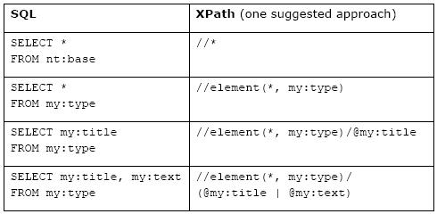
JCR SQL Query
Columns - Properties
Notes:
34

Slide 35

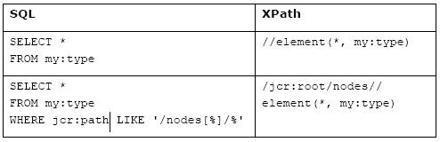
JCR SQL Query
Notes:
35

Slide 36

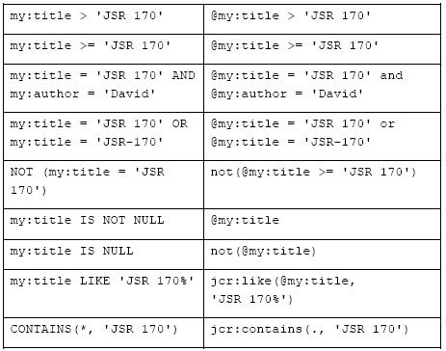
JCR SQL Query – Comparisons
Notes:
36

Slide 37

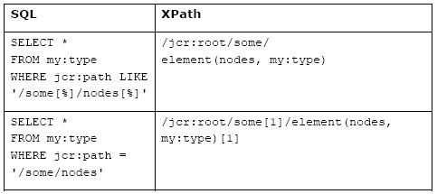
JCR SQL Query – Same name siblings
Notes:
37

Slide 38

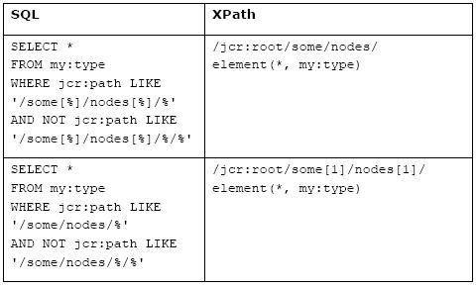
JCR SQL Query
Notes:
38

Slide 39

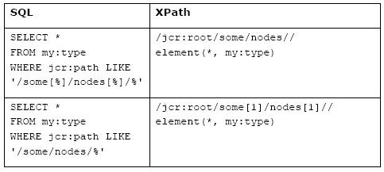
JCR SQL Query
Notes:
39

Slide 40

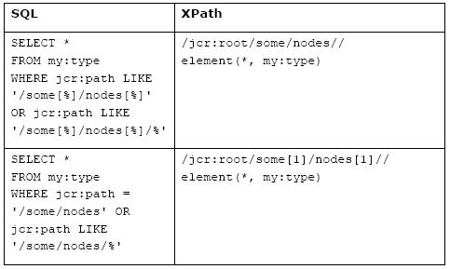
JCR SQL Query – any descendant node
Notes:
40

Slide 41

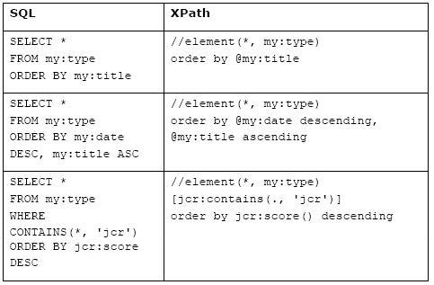
JCR SQL Query – ORDER BY
Notes:
41

Slide 42
Like and contains
jcr:like Function
/jcr:root/document/para[jcr:like(@title,'%Java%')]
jcr:contains Function
//*[jcr:contains(., 'JSR 170')]
//*[jcr:contains(@myapp:title, 'JSR 170')]
Notes:
42

Slide 43
JCR Configuration
Notes:
43

Slide 44
JCR Configuration
File: webapps/platform-extension/WEB-INF/conf/jcr/jcr-configuration.xml
The RepositoryServiceConfiguration points to “war:/conf/jcr/repository-configuration.xml” This file can be found in: webapps/portal/WEB-INF/conf/jcr/repository-configuration.xml
(These files might be overwritten in another webapp. See module eXo extensions.)
You must not manipulate these files!
Notes:
44

Slide 45
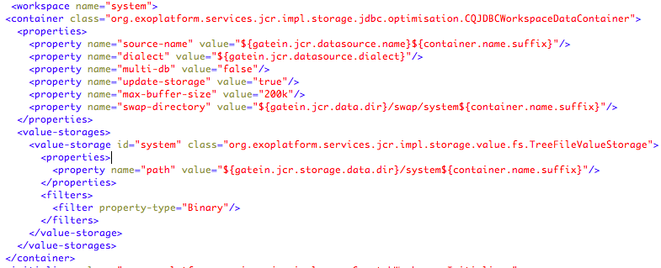
JCR Configuration
Example: “war:/conf/jcr/repository-configuration.xml”
Notes:
45

Slide 46
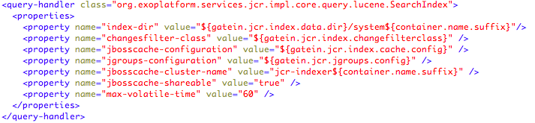
JCR Lucene Configuration
Example: “war:/conf/jcr/repository-configuration.xml”, Lucene index defined for each workspace.
Notes:
46

Slide 47
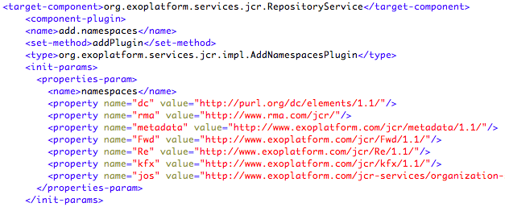
JCR Namespace Configuration
Example: /webapps/ecm-wcm-extension/WEB-INF/conf/dms-extension/dms/jcr-component-plugins-configuration.xml
Notes:
47

Slide 48
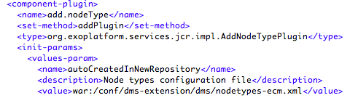
JCR NodeType Configuration
Example: /webapps/ecm-wcm-extension/WEB-INF/conf/dms-extension/dms/jcr-component-plugins-configuration.xml (same component plugin)
Notes:
48

Slide 49
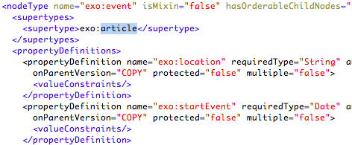
JCR NodeType Configuration
Example: /webapps/ecm-wcm-extension/WEB-INF/conf/dms-extension/dms/nodetypes-ecm.xml
Notes:
49

Slide 50
JCR Coding
Notes:
50

Slide 51
JCR Coding – RepositoryService
In order to access to the JCR you need to use the RepositoryService
As you want to follow the principle of Inversion of Control, you must not access the service directly. You need a Container to access the service.
With this command you get your current container:
ExoContainer myContainer = ExoContainerContext.getCurrentContainer();
The container gives us the instace of the RepositoryService:
RepositoryService repositoryService = (RepositoryService) myContainer.getComponentInstance(RepositoryService.class);
There is only one repository, always use the default repository,
Repository repository = repositoryService.getDefaultRepository();
Notes:
51

Slide 52
JCR Coding – JCR Session
For opening a session you have to login to a workspace.
Credentials credentials = new SimpleCredentials("root", "gtn".toCharArray()); // get a session on workspace ”collaboration” Session jcrSession = repository.login(credentials, "collaboration");
System Session
Has ulimited prermission, use it with care! And never on user operations!
Session jcrSession = repository.getSystemSession(“collaboration”)
Notes:
52

Slide 53
JCR Coding – JCR Session
import javax.jcr.*
import javax.jcr.query.*
import org.exoplatform.services.jcr.RepositoryService
import org.exoplatform.container.ExoContainerContext;
ExoContainer myContainer = ExoContainerContext.getCurrentContainer();
RepositoryService repositoryService = (RepositoryService) myContainer.getComponentInstance(RepositoryService.class);
Repository repository = repositoryService.getDefaultRepository();
Credentials credentials = new SimpleCredentials("root", "gtn".toCharArray()); // get a session on workspace ”collaboration” Session jcrSession = repository.login(credentials, "collaboration");
Notes:
53

Slide 54
JCR Coding – Node
// Get the root node of the workspace
Node root = jcrSession.getRootNode();
// Search all child nodes of the root node
NodeIterator iterator = root.getNodes();
while (iterator.hasNext()) {
Node iterNode= iterator.nextNode();
System.out.println( iterNode.getName() + “ “ + node.getProperty(”jcr:uuid").getValue().getString() );
}
Notes:
54

Slide 55
JCR Coding – Queries
More details can be found in the specification :
QueryManager qm = jcrSession.getWorkspace().getQueryManager();
Query q = qm.createQuery("select * from exo:article", Query.SQL)
NodeIterator ni = q.execute().getNodes();
…
Node.getIndex() : returns the index of this node within the ordered set of its same-name sibling nodes.
MultiValue Properties:
Value[] values = node.getProperty(“exo:keywords”).getValues()
Notes:
55

Slide 56
JCR Coding – Node Manipulation
Node newNode = node.addNode(“nodeName”, “exo:article”);
Value titleValue = jcrSession.getValueFactory().createValue(“Great new Bikes”);
newNode.setPropery(“exo:title”, titleValue);
jcrSession.save();
Notes:
56

Slide 57
JCR Exercises
Notes:
57

Slide 58
Exercises
Open the Sites Explorer and test the export and import.
Import to a different location
Compare the System View and Document View
Try out the option of UUID conflicts
Try out some queries using the Sites Explorer (Advanced Search)
Notes:
58

Slide 59
JCR for Developers
Notes:
59

